Slide 1
Diabetes Prediction
-Neha Shelhalkar

Slide 2
Problem Statement
Develop a machine learning model that can accurately predict the chances of individuals developing diabetes. Analyze data related to their health and lifestyle factors to build a model that can estimate the risk of diabetes with great accuracy.

Slide 3
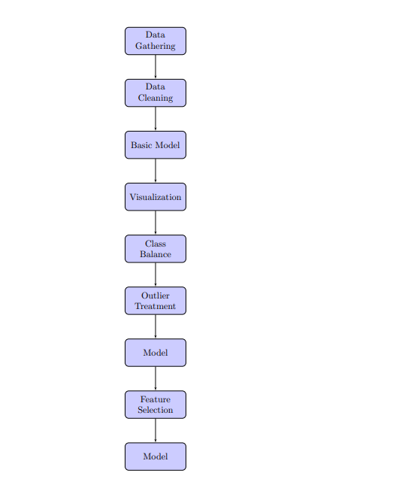
Project flow

Slide 4
Information About Dataset
Gender
Age
Hypertension
Heart disease
Smoking history
Bmi
Hba1c level
Blood glucose level
Diabetes (Target column)

Slide 5
Data Cleaning
Data was cleaned.
Datatype conversion.

Slide 6
Basic Model
 | Model Name | Accuracy | Precision | Recall | F1_score
1 | DT | 95.185 | 0.719088 | 0.707620 | 0.713308
2 | RF | 96.915 | 0.669268 | 0.944115 | 0.783281
3 | KNN | 95.425 | 0.518007 | 0.885128 | 0.653540
4 | NB | 90.510 | 0.275510 | 0.399130 | 0.325994
5 | SVM | 94.830 | 0.379352 | 1.000000 | 0.550044
6 | Logistic | 95.155 | 0.556423 | 0.801210 | 0.656748
7 | Ada-Boost | 95.355 | 0.720288 | 0.721587 | 0.720937
8 | XG-Boost | 97.065 | 0.674070 | 0.962296 | 0.792799
9 | Feature selection | 96.915 | 0.669268 | 0.944115 | 0.783281

Slide 7
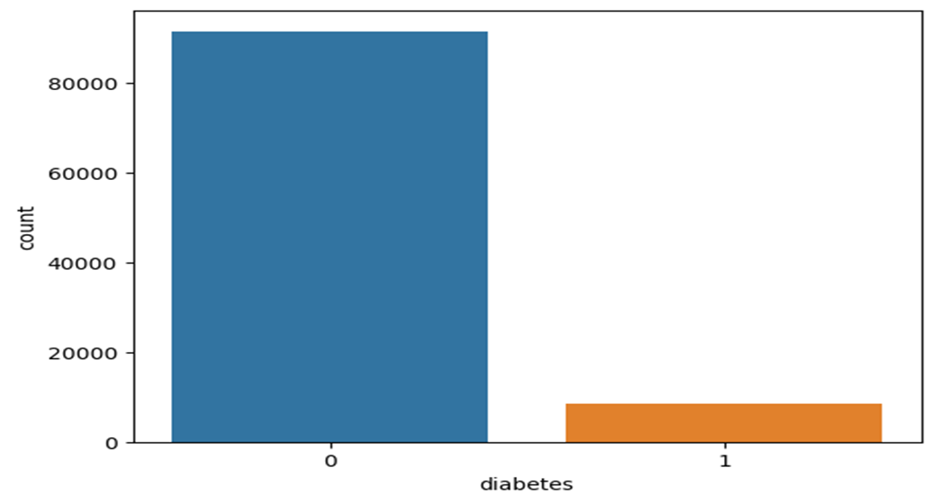
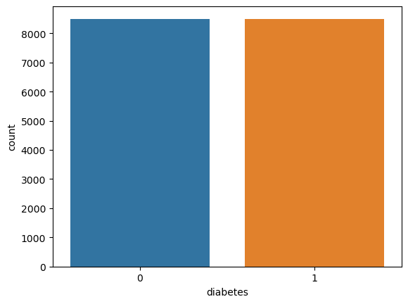
Class imbalance
Before Class Imbalance
After Class Imbalance

Slide 8
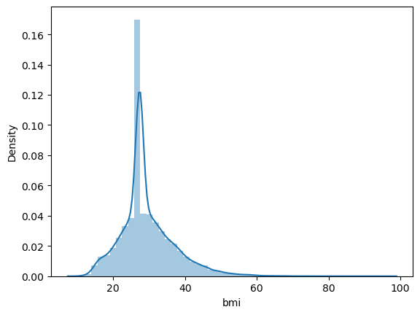
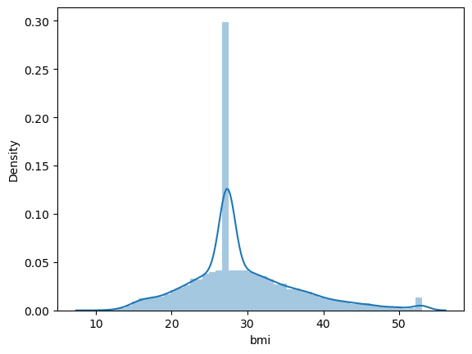
Outliers Treatment
Before outliers
After outliers

Slide 9
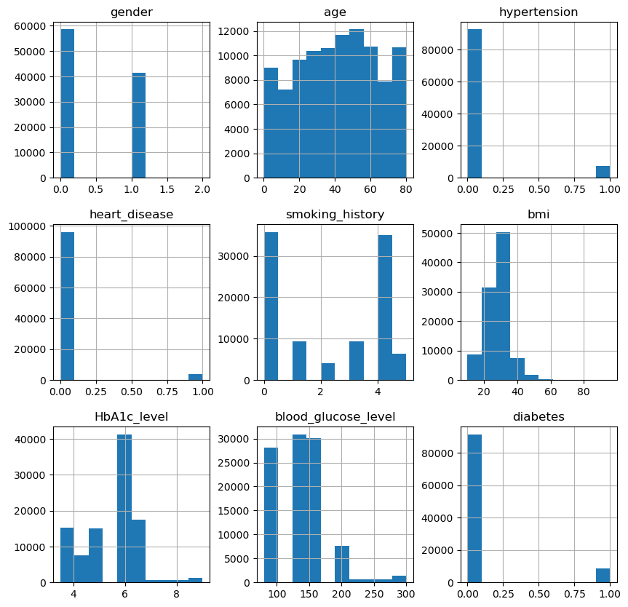
VISUALIzAtION

Slide 10
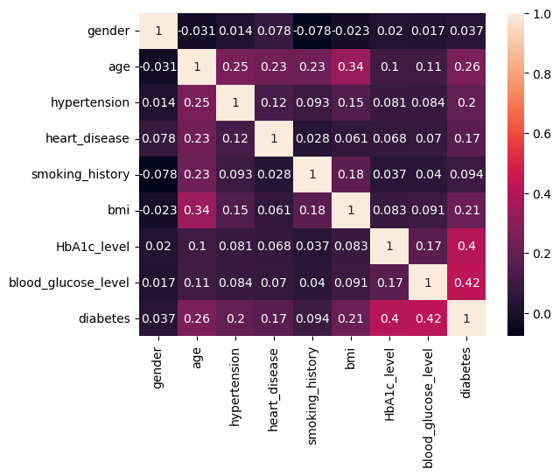
Heatmap
Feature selection
Chi Square

Slide 11
Models
 | Model Name | Accuracy | Precision | Recall | F1_score
1 | DT | 87.411765 | 0.883882 | 0.877681 | 0.876157
2 | RF | 90.176471 | 0.908723 | 0.900803 | 0.904173
3 | KNN | 86.852941 | 0.872328 | 0.849323 | 0.871070
4 | NB | 68.117647 | 0.674177 | 0.691761 | 0.681075
5 | SVM | 86.029412 | 0.882727 | 0.836549 | 0.870752
6 | Logistic | 88.382353 | 0.836511 | 0.888372 | 0.885540
7 | Ada-Boost | 87.588235 | 0.885038 | 0.872934 | 0.878944
8 | XG-Boost | 91.088235 | 0.915656 | 0.908935 | 0.912856
9 | Feature selection | 90.352941 | 0.902369 | 0.917744 | 0.909991

Slide 12
demerits
CONCLUSION
The XG Boost model performs the best with an accuracy of 91% Based on the F1 score, XG boost is the best model with a score of 0.912856 indicating a good balance between precision and recall.
In some cases, gender might not be a significant predictor of diabetes risk, especially if the dataset is not diverse or if other factors overshadow its importance.

Slide 13
Thank You…

